Slide 1
User Authentication and Access Control and wireless security and firewall

Slide 2
Remote User-Authentication Principles
What exactly is user authentication?
It's a two-step process:
Identification: This is you claiming an identity. You walk up to a system and say, 'Hi, I'm Alice.' You're presenting your username or User ID. This part is usually not a secret.
Verification: This is you proving you are really Alice. You do this by providing a secret(your password). The system checks this secret against what it has on file.
So, in our example:
“ABTOKLAS” is Alice's public Identifier.
Her “password” is the secret Authentication Information.
If both match, the system trusts that you are who you claim to be and can then set your permissions and track your activity.

Slide 3
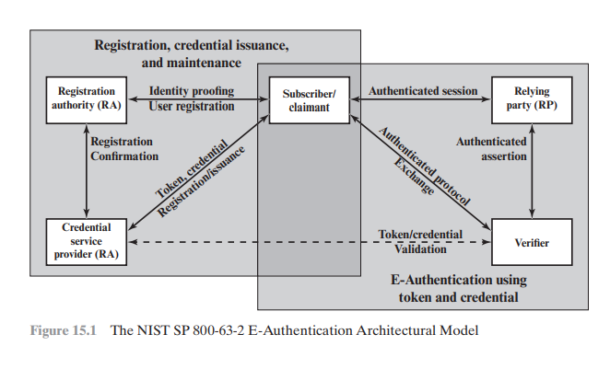

Slide 4

NIST Model for Electronic User Authentication
A standard framework for user authentication process, defined by the National Institute of Standards and Technology (NIST).
According to the SP 800-63-2 Architectural Model. There are different actor involve
Registration Authority (RA): This is the trusted office that checks your physical ID (like a passport) and vouches for you. They do the initial 'identity proofing'.
Credential Service Provider (CSP): This is the entity that creates and issues your electronic credential—like a digital ID card. In many systems, the RA and CSP are part of the same organization.
Subscriber/Claimant: User being authenticated
Verifier: When you later try to log in, the verifier is the software that challenges you for your password or token.
Relying Party (RP): This is the final application or service you want to access (like your email server). It trusts the Verifier's decision.
Process: Registration → Credential Issuance → Authentication → Authorization
(So the flow is: Get registered → Get your digital credential → Use it to prove who you are → Access services.)

Slide 5
Means of Authentication
How can you prove your identity? There are four general categories, which we call 'factors of authentication':
Something you know: This is the most common—a password, a PIN, or answers to security questions.
Something you possess: A physical object you have, like a smart card, a security token that generates codes, or even your physical house key.
Something you are (Static Biometrics): This uses your unique physical characteristics, like your fingerprint, your retina pattern, or your face.
Something you do (Dynamic Biometrics): This uses behavioral patterns, like your voice rhythm, your handwriting, or even your unique typing rhythm.
Multi-factor authentication combines these for stronger security. For logging into a network, the most common combination is something you know (a password) used with something you possess (a cryptographic key).

Slide 6
Mutual Authentication:
Often, it's not enough for just the server to verify you. You might also want to verify that you're talking to the real server and not a fake one set up by a hacker. This two-way verification is called Mutual Authentication.
The main goals here are to confirm each other's identity. Securely exchange a session key that they can use to encrypt the rest of their conversation. The biggest threat to this process is a Replay Attack. Imagine an eavesdropper records your login sequence and just plays it back later to impersonate you.
There are different types of replay attacks:
Type 1: Just copy and replay the message later.
Type 2 & 3: Replay a message while its timestamp is still valid, possibly while blocking the original message.
Type 4: Send your own message back to you, which can cause confusion.

Slide 7
Countering Replay Attacks
So, how do we stop these replay attacks? We have two main weapons:
Timestamps: Every message gets a 'born-on' date. If a message arrives too late, it's rejected. Simple, right? The problem is it requires all computers involved to have perfectly synchronized clocks. If clocks drift apart, it causes big problems.
Challenge/Response: This is like a secret handshake.
For Example: You (Party A) say, "Prove you're real by answering this random number I just made up: 57."
The server (Party B) has to take that number, encrypt it with your shared secret key, and send the encrypted result back.
You decrypt it, and if it gives you back '57', you know it's the real server.
Challenge/Response is very secure but requires extra back-and-forth messages (a 'handshake'), which isn't ideal for all situations.

Slide 8
One-Way Authentication
Not all authentication needs to be mutual. The classic example is email. When you send an email, you and the recipient aren't online at the same time.This creates special requirements:
The envelope (the 'To:' and 'From:' addresses) must be readable by the email system so it can route the message.
But the body of the message should be encrypted so the mail servers can't read it.
The recipient also wants assurance that the email actually came from you.
So, we need a way to authenticate the sender without requiring the recipient to be online for a complex handshake

Slide 9
Remote Authentication Using Symmetric Encryption
Now, let's talk about how to do this authentication practically using symmetric encryption, where everyone shares a secret key.
Managing secret keys between every possible pair of users is a nightmare. The solution is to use a trusted middleman called a Key Distribution Center (KDC).Here's how it works:
You and every other user have a single, long-term master key that you share only with the KDC.
When you want to talk to someone else, you ask the KDC for a temporary session key.
The KDC generates this session key and sends it to both of you, but it's encrypted inside a package using your respective master keys.
This way, you only have to protect one master key, and the KDC handles the rest.

Slide 10
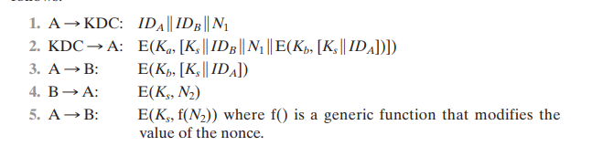
Needham-Schroeder Protocol
Alice tells the KDC: "I'm Alice, I want to talk to Bob, here's a random number N₁."
The KDC sends Alice a package containing a new session key (K_s). Part of this package is a ticket for Bob, encrypted with Bob's master key. This ticket also contains the session key.
Alice forwards this ticket to Bob. Bob can open it because it's encrypted with his key, and he finds the session key inside.
Bob sends Alice a random number N₂, encrypted with the new session key, to prove he got the key.
Alice performs a simple operation on N₂ (like adding 1), encrypts it, and sends it back to prove she also knows the key.
This 'handshake' in steps 4 and 5 prevents a simple replay of step 3. However, if an attacker ever stole an old session key, they could impersonate Alice. This is a vulnerability.
Vulnerability: Susceptible to replay attacks if old session keys are compromised

Slide 11
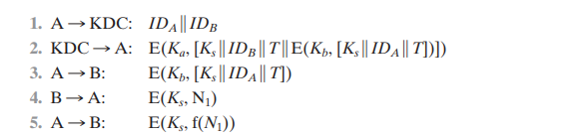
Denning Protocol Improvement
To fix the problem in Needham-Schroeder, Dorothy Denning added timestamps.
The main change is that the KDC now puts a timestamp T inside the tickets. Now, when Bob receives the ticket from Alice, he checks the timestamp. If it's too old, he rejects it.
Advantage: Even if an attacker steals an old session key, the timestamp on the ticket will have expired, making it useless.
Disadvantage: We're back to the problem of requiring synchronized clocks across the network

Slide 12
Suppress-Replay Attacks
But timestamps introduce their own new, clever attack called a Suppress-Replay Attack.
Imagine Alice's clock is 5 minutes ahead of Bob's.
Alice sends a request with her timestamp, which is 5 minutes in Bob's future.
An attacker, Eve, intercepts and holds onto this message.
5 minutes later, Bob's clock 'catches up' to the timestamp.
Eve now replays the message. Bob sees a fresh, valid timestamp and accepts it!
This is a tricky problem. The solutions are either to constantly synchronize clocks very carefully or to go back to using nonces (random challenges) which are not vulnerable to this timing trick.

Slide 13
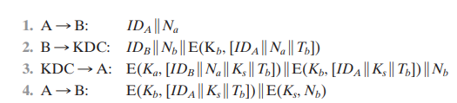
Enhanced Authentication Protocol
Researchers kept refining the protocols to be more secure. This is one of the improved versions.
It's more complex, but notice a few key things:
It uses nonces (N-a, N-b) from both Alice and Bob, so it doesn't rely solely on timestamps.
The KDC gives Alice a reusable 'ticket' to talk to Bob. She can keep this ticket and use it for a certain period without going back to the KDC.
This ticket is encrypted with Bob's key, so Alice can't tamper with it.
This protocol is a nice balance, providing strong security against replays while also being efficient for multiple connections.

Slide 14
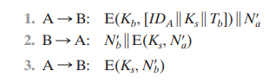
Subsequent Session Protocol
What happens when Alice wants to talk to Bob again, and her ticket is still valid?
She doesn't need to bother the KDC again! She can just use the protocol on this slide:
She sends the old ticket to Bob, plus a new random number.
Bob responds with his own new random number.
They complete a quick handshake.
This is fast and efficient, and because they use new nonces each time, it's still secure against replays for this new session.

Slide 15
One-Way Authentication with Symmetric Encryption
Let's go back to our email example. How can we do one-way authentication with a KDC?
The protocol is similar to the first part of Needham-Schroeder, but we remove the mutual handshake. Alice gets a ticket for Bob and the session key from the KDC. She then sends Bob two things:
The ticket (which Bob can decrypt).
The actual email message, encrypted with the session key.
Bob uses his master key to open the ticket, gets the session key, and then uses that to decrypt the email. This proves the message came from someone who got a valid ticket from the KDC (i.e., Alice). It's not as strong as mutual authentication, but it works for email.

Slide 16
Access Control

Slide 17
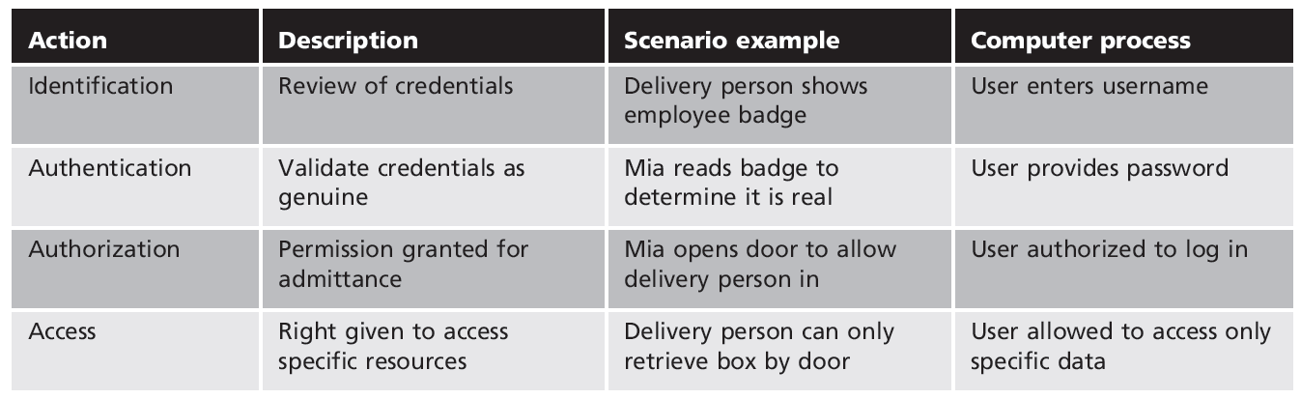

Slide 18
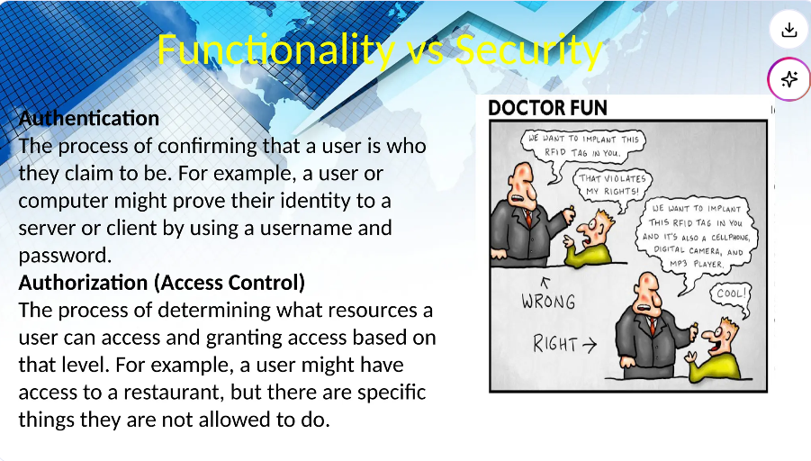

Slide 19
Authentication and Access control
Authentication: Verifying identity using credentials like passwords, biometrics, or tokens.
Authentication Factors:
Knowledge-Based: Something the user knows (e.g., passwords, PINs).
Possession-Based: Something the user has (e.g., smart cards, tokens).
Inherence-Based: Something the user is (e.g., fingerprints, retina scans).
Multifactor Authentication (MFA): Combines two or more factors to enhance security (e.g., password + smartphone app).
Single Sign-On (SSO): Enables one login for multiple systems, reducing password fatigue but increasing risk if compromised.
Authentication Protocols: Examples include Kerberos, OAuth, and OpenID Connect, securing authentication during data exchange.

Slide 20
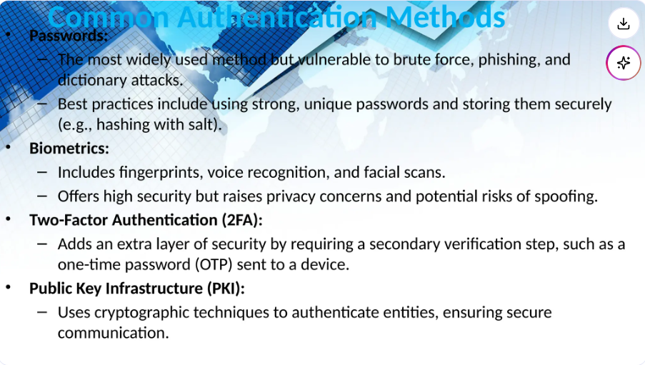

Slide 21
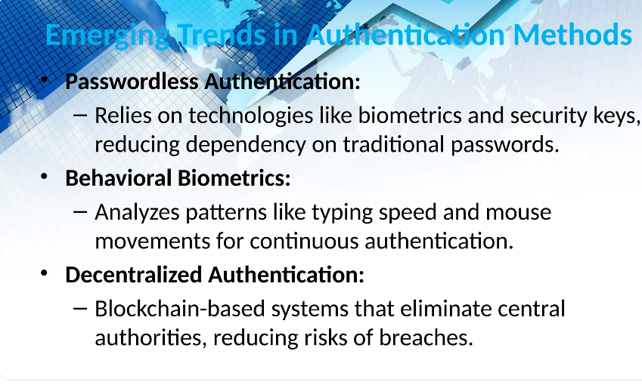

Slide 22
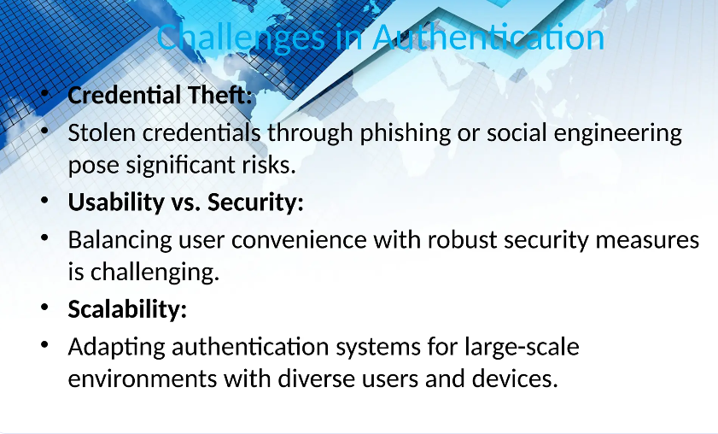

Slide 23
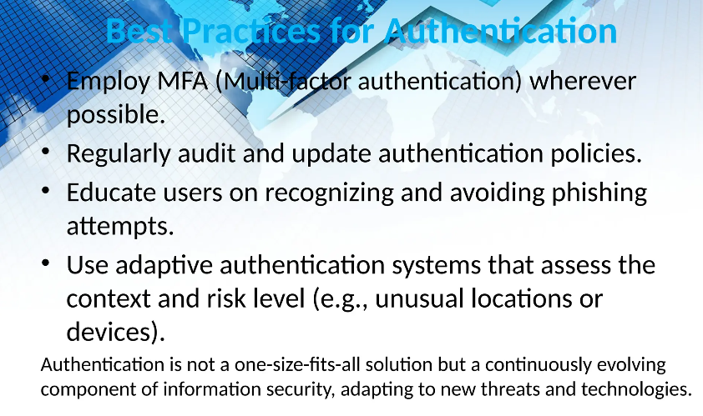

Slide 24
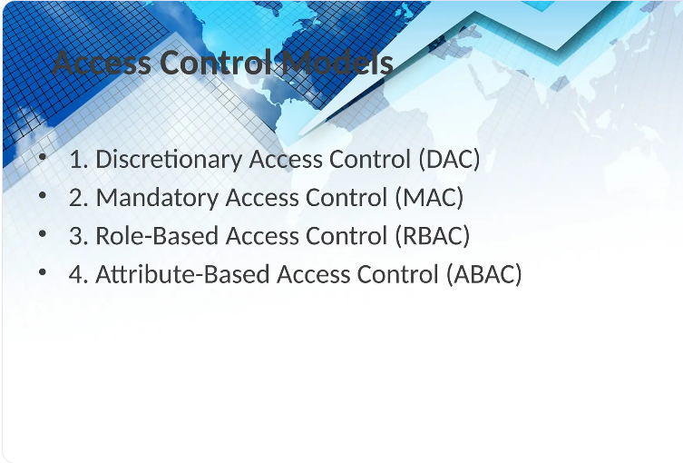

Slide 25
Discretionary Access Control(DAC)
Discretionary Access Control empowers the owners of resources to decide who can access them. The control over permissions lies entirely with the resource owner.
Core Characteristics
Ownership-Centric: The individual who owns the resource holds complete authority over its access rights.
Highly Customizable: Permissions can be tailored for specific users or groups, allowing detailed control.
Access Control Lists (ACLs): Typically managed through lists that define which users or groups can perform actions like reading, writing, or executing the resource.
Benefits
Straightforward and easy for users to manage.
Provides fine-grained control over who can do what.
Drawbacks
Susceptible to risks such as privilege escalation and threats from insiders.
The absence of centralized oversight complicates the enforcement of organization-wide security policies.
Illustration For example, when a user creates a file on their device, they can specify exactly which other users are allowed to read, modify, or run that file.

Slide 26
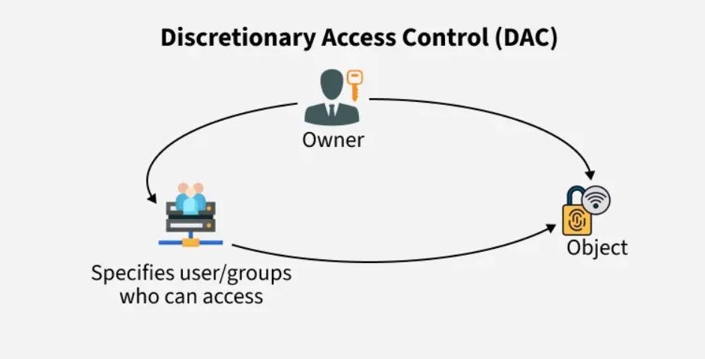
DAC Diagram:

Slide 27
Mandatory Access Control (MAC)
Mandatory Access Control is a security model where access rules are strictly enforced by a central authority, and users have no ability to alter these rules.
Core Characteristics
Security Labels and Clearance Levels: Both users and resources receive specific security classifications (such as "Top Secret" or "Confidential"), and access is permitted only when these labels align.
Non-Discretionary Access: Users cannot modify permissions themselves.
Centralized Authority: Only system administrators have the power to set or change access policies.
Benefits
Delivers a high level of security.
Perfectly suited for settings demanding rigorous confidentiality, like military or government operations.
Drawbacks
Can be rigid and less intuitive for users.
Challenging to deploy and maintain in environments that require frequent changes.
Illustration
For example, a document marked "Top Secret" is accessible exclusively to individuals holding "Top Secret" clearance.

Slide 28
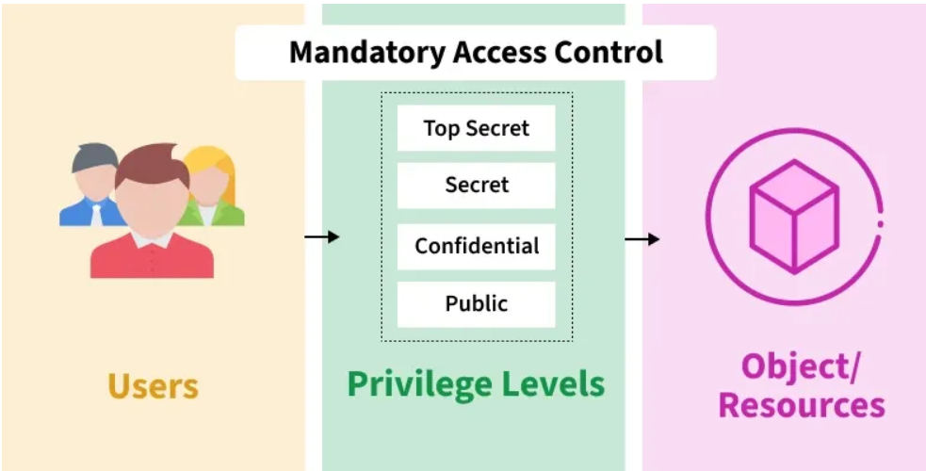
MAC Diagram:

Slide 29
Role-Based Access Control (RBAC)
RBAC manages user permissions by assigning them to specific roles instead of individual users, making access control more efficient.
Core Characteristics
Role-Focused: Users receive roles such as Admin, Editor, or Viewer, each with a set of predefined access rights.
Highly Scalable: Ideal for organizations with complex hierarchies and large user bases.
Duty Segregation: Roles can be structured to avoid conflicts of interest, for example, ensuring one person cannot both approve and audit the same transaction.
Benefits
Simplifies administration in large enterprises.
Enhances the ease of auditing and meeting compliance requirements.
Limitations
Setting up roles initially can be intricate and time-consuming.
Lacks flexibility to adapt to contextual or real-time conditions.
Practical Example
Within a company, an "HR Manager" role might be granted access to employee information, whereas a "Finance Manager" role would have permissions related to payroll data.

Slide 30
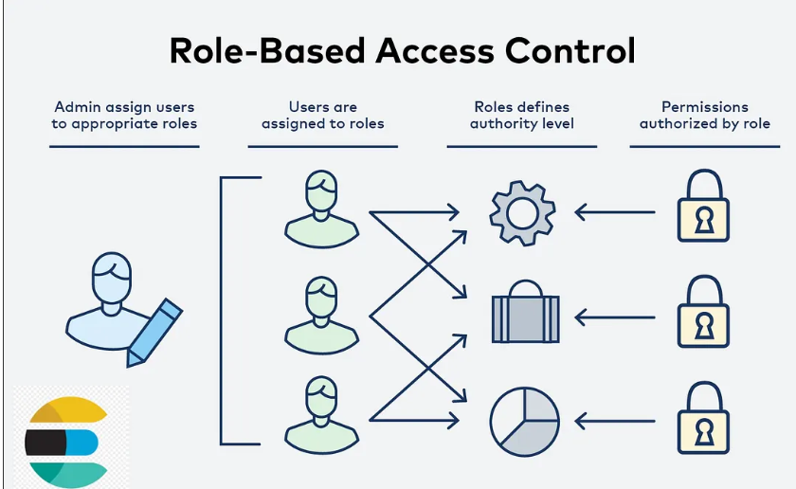
RBAC Diagram:

Slide 31
Attribute-Based Access Control (ABAC)
ABAC determines access rights by evaluating various attributes related to the user, the resource, and the surrounding environment, enabling real-time, adaptive access management.
Core Characteristics
Policy-Driven: Access permissions are governed by rules that assess specific attributes.
Context-Sensitive and Dynamic: Factors such as the user's role, current time, location, and device type influence access decisions.
Granular Access: Supports detailed and conditional policies for precise control.
Benefits
Offers exceptional flexibility, making it suitable for environments that change frequently.
Capable of handling intricate policies that involve multiple attribute combinations.
Challenges
Can impose significant processing demands.
Crafting and maintaining policies can be complex and resource-intensive.
Illustrative Example
Access might be permitted only if the individual is an employee (attribute: role), accessing during business hours (attribute: time), and using a company-approved device (attribute: device type).

Slide 32
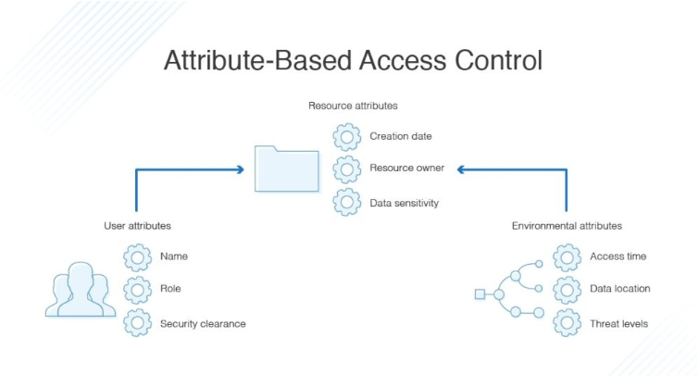
ABAC Diagram:

Slide 33
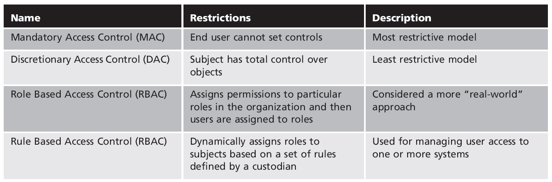

Slide 34
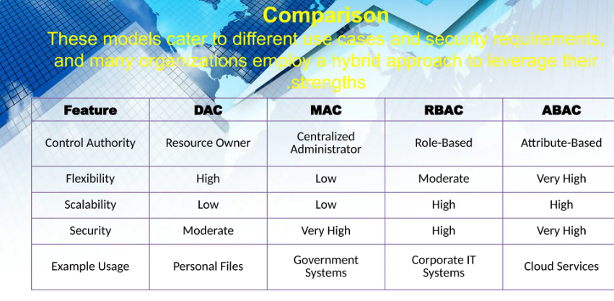

Slide 35
DDoS Attack

Slide 36
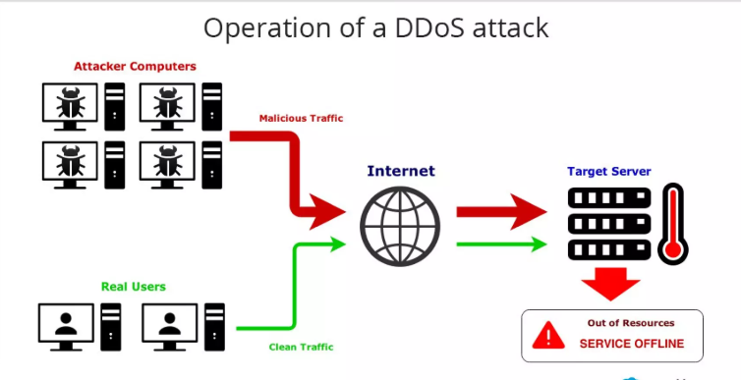
Intro:
DDoS attacks use multiple systems, often compromised computers (botnets), to attack a single target. Examples are amplification attacks and botnet-based attacks. In an amplification attack, attackers use services like DNS to send a small query that generates a large response, flooding the victim with data. Botnets coordinate many infected computers to send attack traffic from multiple sources, making it hard to defend against..
Denial of service (DOS) is a network security attack, in which, the hacker makes the system or data unavailable to someone who needs it. Hacker tries to make a network, system, or machine unavailable by flooding it with fake requests or traffic. This prevents real users from accessing it, causing anything from slowdowns to complete shutdowns.

Slide 37
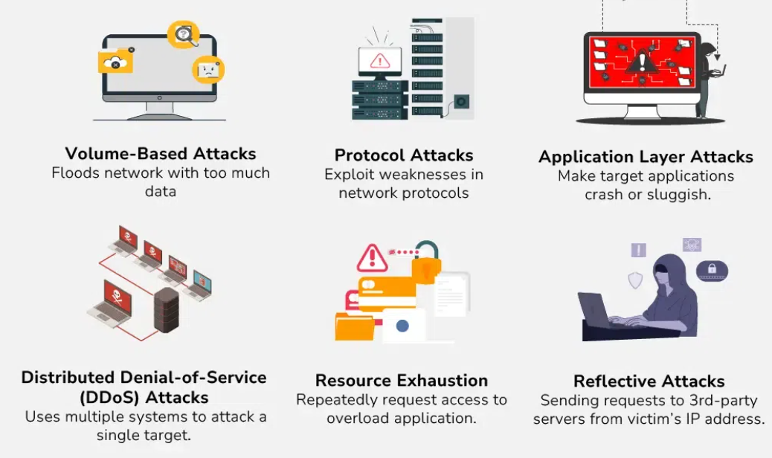
Types of DoS Attack

Slide 38
Wireless security

Slide 39
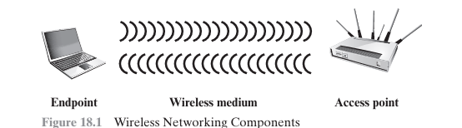
Wireless Network Components & Attack Points
Wireless Client – Phone, laptop, IoT device
Access Point – Wi-Fi hotspot, cell tower
Transmission Medium – Radio waves (vulnerable to interception)
Example: A Wi-Fi-enabled laptop in a café connects to a rogue AP instead of the legitimate one.

Slide 40
Securing Wireless Transmissions
Goal: Prevent eavesdropping, tampering, disruption
Signal Hiding Techniques
Disable SSID broadcasting
Use cryptic SSID names
Reduce signal strength
Use directional antennas
Encryption
Use WPA3, AES-CCMP Example: Encrypt all Wi-Fi traffic so intercepted data is unreadable.
Securing Wireless Access Points
Threat: Unauthorized network access Solution: IEEE 802.1X Port-Based Access Control
Requires authentication before granting network access
Prevents rogue APs Example: Employee must enter username/password/certificate to connect to corporate Wi-Fi.
Example: Encrypt all Wi-Fi traffic so intercepted data is unreadable.

Slide 41
Securing Wireless Networks – Best Practices
Use encryption (WPA3 for router-to-router)
Install antivirus/firewall on all endpoints
Turn off identifier broadcasting
Change default router SSID
Change default admin password
Use MAC filtering (with caution – can be spoofed)
Example: Home Wi-Fi → Change SSID from “Linksys” to “HomeNet_secure”, disable SSID broadcast, enable WPA3.

Slide 42
Firework
A firewall is a network security system that:
Creates a controlled barrier between trusted internal networks and untrusted external networks (e.g., the Internet)
Inspects and controls traffic based on security rules
Provides a single point of monitoring and enforcement
“The function of a strong position is to make the forces holding it practically unassailable.” – Carl Von Clausewitz
Example:
A company uses a firewall to allow employees to browse the web while blocking hackers from entering the network.

Slide 43
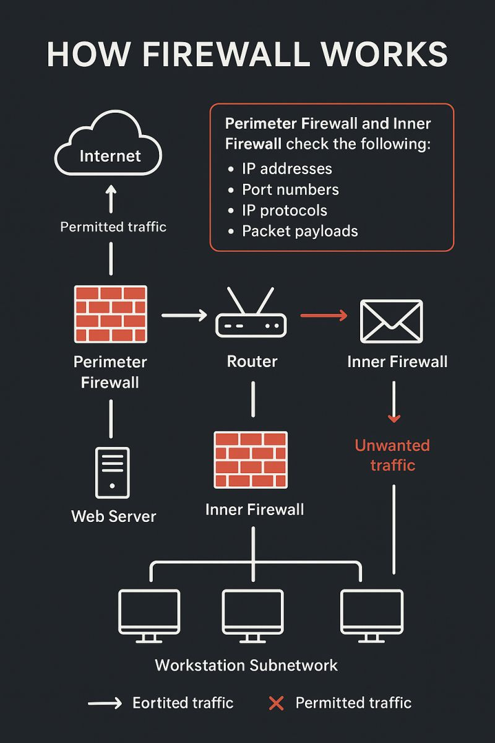
Firewall characteristics:
Firewalls are designed to:
Force all traffic through them – no bypass allowed
Permit only authorized traffic – defined by security policy
Be immune to attacks – run on hardened, secure systems
Control Techniques:
Service Control – What services (HTTP, SMTP) are allowed
Direction Control – Which way traffic can flow
User Control – Who can access (via authentication)
Behavior Control – How services are used (e.g., block spam)
Example: Only HR can access the payroll server, and only during work hours.

Slide 44
Types of firewall
Packet Filtering Firewall
Filters based on IP, port, protocol
Fast but minimal inspection
Example: Block all traffic from a specific IP
Stateful Inspection Firewall
Tracks active connections in a state table
Only allows return traffic for established sessions
Example: Allow inbound response only if outbound request was made first
Application-Level Gateway (Proxy)
Acts as an intermediary for app traffic (e.g., HTTP, FTP)
Inspects full content, enforces detailed policies
Example: Web proxy that blocks malicious sites
Circuit-Level Gateway
Relays TCP connections without deep inspection
Often used with SOCKS protocol
Example: Secure relay for remote user VPN access

Slide 45
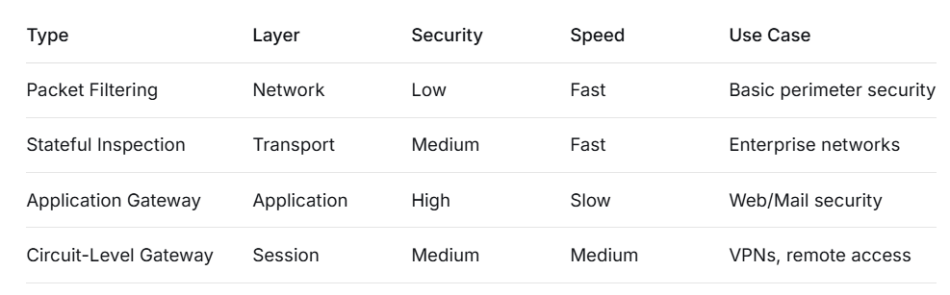
Summary:

Slide 46
References:
Stallings, W. (2017). Cryptography and Network Security: Principles and Practice (7th ed.). Pearson. Chapter: User Authentication.
Stallings, W. (2017). Cryptography and Network Security: Principles and Practice (7th ed.). Pearson. Chapter: Access Control.
Stallings, W. (2017). Cryptography and Network Security: Principles and Practice (7th ed.). Pearson. Chapter: Wireless security.
Stallings, W. (2017). Cryptography and Network Security: Principles and Practice (7th ed.). Pearson. Chapter: Firewalls.
https://sheerazali.com/how-to-kerberos-its-components-and-function/
https://www.youtube.com/watch?v=5N242XcKAsM
https://www.slideshare.net/slideshow/009-authentication-and-access-control-pptx/273786341#4
https://www.apono.io/blog/rbac-vs-abac-choosing-the-right-access-control-model-for-your-organization/
https://levelup.gitconnected.com/implementing-role-based-access-control-rbac-in-elasticsearch-for-security-65a44042aaf5?gi=0fa7d24977ab
https://www.geeksforgeeks.org/computer-networks/difference-between-dac-and-mac/

